Slide 1
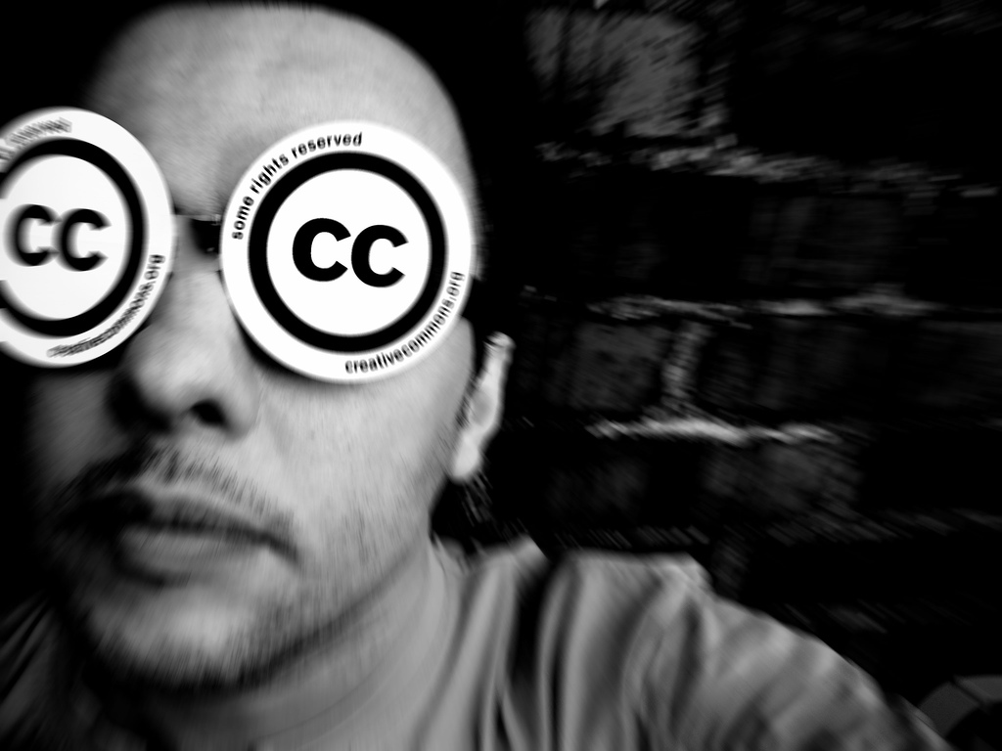



Navigating the World of Copyright
Creative Commons for Multimedia
Jessica Coates
Project Manager, Creative Commons Clinic
April 2009
CC by Franz Patzig, http://www.flickr.com/photos/franzlife/298169221/ under a Creative Commons Attribution 2.0 licence, http://creativecommons.org/licenses/by/2.0/deed.en
part of the Creative Commons international initiative
CRICOS No. 00213J

Slide 2
©
by granting creators rights to control publication you ensure that they will be remunerated which gives incentive for them to create
Notes:
In writing the licences, the main goal was to ensure that the licences are:
Voluntary – contrary to some claims, CC isn’t anti-copyright. It just aims to provide options for those copyright owners who do want to make their material more freely available
Flexible – unlike other parts of the open access movement, CC licences are specifically designed to provide a range of options for licensors, so that they can choose exactly how they want their material to be used
Easy to understand – the academics designing the licences felt that one of the biggest problems with default copyright law is that its so hard for both copyright owners and users to understand. So the licences are specifically designed to be as simple as possible.
And, of course, freely available for everyone to use

Slide 3
©
All rights reserved
Notes:
In writing the licences, the main goal was to ensure that the licences are:
Voluntary – contrary to some claims, CC isn’t anti-copyright. It just aims to provide options for those copyright owners who do want to make their material more freely available
Flexible – unlike other parts of the open access movement, CC licences are specifically designed to provide a range of options for licensors, so that they can choose exactly how they want their material to be used
Easy to understand – the academics designing the licences felt that one of the biggest problems with default copyright law is that its so hard for both copyright owners and users to understand. So the licences are specifically designed to be as simple as possible.
And, of course, freely available for everyone to use

Slide 4
©
Can’t touch this
Notes:
In writing the licences, the main goal was to ensure that the licences are:
Voluntary – contrary to some claims, CC isn’t anti-copyright. It just aims to provide options for those copyright owners who do want to make their material more freely available
Flexible – unlike other parts of the open access movement, CC licences are specifically designed to provide a range of options for licensors, so that they can choose exactly how they want their material to be used
Easy to understand – the academics designing the licences felt that one of the biggest problems with default copyright law is that its so hard for both copyright owners and users to understand. So the licences are specifically designed to be as simple as possible.
And, of course, freely available for everyone to use

Slide 5
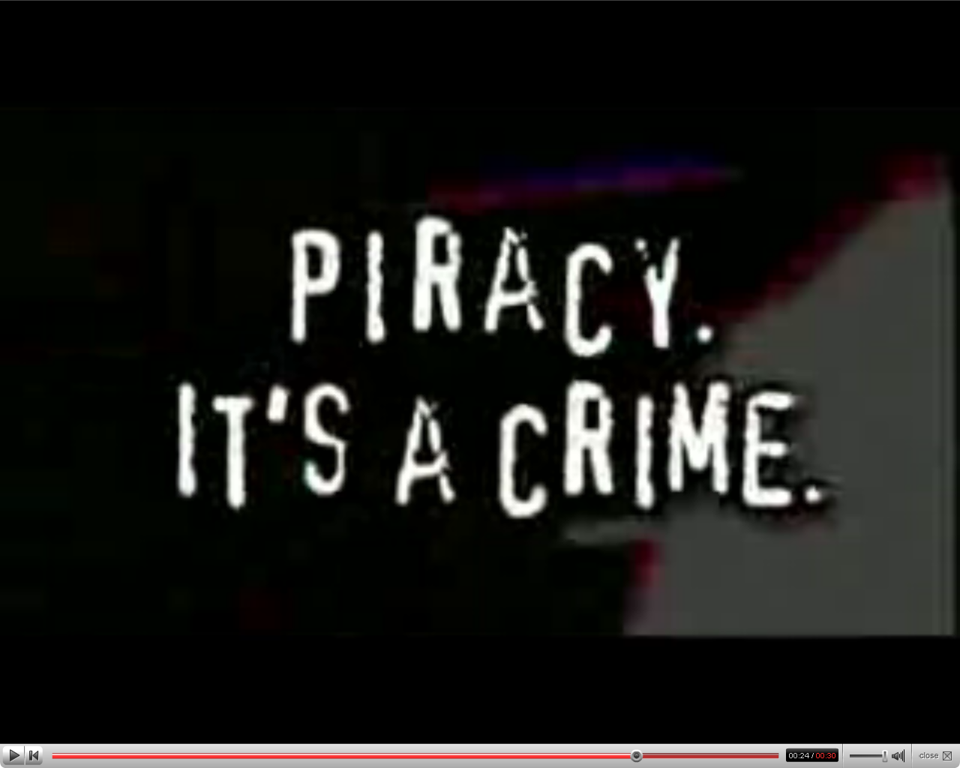



AUSTRALIA
http://www.youtube.com/watch?v=l5SmrHNWhak&feature=related
part of the Creative Commons international initiative
CRICOS No. 00213J
Notes:
Standard copyright law says that you can’t reproduce or communicate creative material (eg movies, books, music etc) without the copyright owner’s permission, except in very limited circumstances
The problem with this in the digital era is that every use of material makes a reproduction. This includes just viewing
This means that, under the default copyright laws, printing out a webpage, emailing a picture to your friend, making a digital collage or remix work etc will all generally infringe copyright

Slide 6
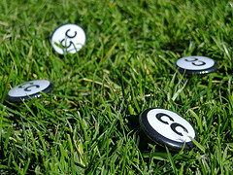
What can you do without permission?
Email a news article to a friend?
Download a song onto your hard drive?
Post a picture/song/film to your blog?
Use a sample in the soundtrack of a short film?
Create a remix or mash up out of video clips?
Use a photo in your slideshow?

Slide 7
What can you do without permission?
Email a news article to a friend?
Download a song onto your hard drive?
Post a picture/song/film to your blog?
Use a sample in the soundtrack of a short film?
Create a remix or mash up out of video clips?
Use a photo in your slideshow?
No
No
No
No
No
No

Slide 8

Important things about copyright
it covers everything you want to use – text, photos, music, videos, computer games, sound effects
it covers everything you want to do – copying, emailing, posting, remixing
even if it’s on the internet (or TV or radio)
even if you’ve bought it, you can’t copy it
there are exceptions, but they’re very narrow
you can get permission, but it’s very hard
Notes:
In writing the licences, the main goal was to ensure that the licences are:
Voluntary – contrary to some claims, CC isn’t anti-copyright. It just aims to provide options for those copyright owners who do want to make their material more freely available
Flexible – unlike other parts of the open access movement, CC licences are specifically designed to provide a range of options for licensors, so that they can choose exactly how they want their material to be used
Easy to understand – the academics designing the licences felt that one of the biggest problems with default copyright law is that its so hard for both copyright owners and users to understand. So the licences are specifically designed to be as simple as possible.
And, of course, freely available for everyone to use

Slide 9
Default copyright is important but…
doesn’t reflect the behaviour of ordinary users
doesn’t reflect the wishes of many creators
makes it difficult to promote, collaborate or remix
prevents digital technologies from being used to their fullest
is a barrier to people making decisions about their own material
makes jobs for lawyers

Slide 10
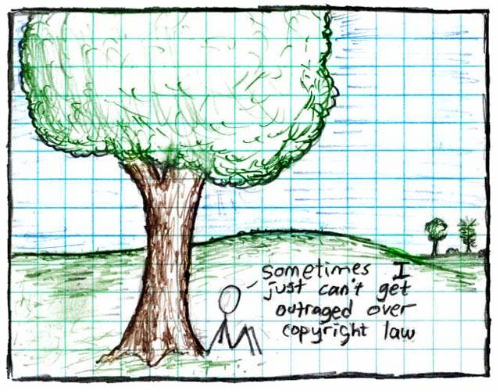
"Copyright", Randall Munroe, http://xkcd.org/14/, Creative Commons Attribution-NonCommercial 2.5 license
AUSTRALIA
part of the Creative Commons international initiative
CRICOS No. 00213J
Notes:
Some just say ignore copyright law – rip, mix, burn
This is ok if you’re an private user, or an obscure artist – can choose to take risk
But doesn’t work for schools, libraries, museums, charities, academics, short film makers entering into competitions, DJs releasing a commercial CD etc
Plus, the music labels and hollywood are suing people now – and in the UK they’re threatening to cut off people’s internet connections.

Slide 11

Aims to make creative material more useable by providing free licences that creators can use to give certain permissions in advance
http://creativecommons.org/videos/building-on-the-past
Notes:
Non-profit
Founded in 2001
These academics became concerned that the default copyright laws that applied in most countries were restricting creativity in the digital environment by preventing people from being able to access, remix and distribute copyright material online
Taking inspiration from the open source movement, they decided to develop a set of licences that creators could use to make their material more freely available without giving up their copyright
They wanted to replace the standard “all rights reserved” model with a new, more flexible, “some rights reserved”

Slide 12
Creates a pool of creative material that can be reused, recycled and remixed - legally
http://creativecommons.org/videos/building-on-the-past
Notes:
Non-profit
Founded in 2001
These academics became concerned that the default copyright laws that applied in most countries were restricting creativity in the digital environment by preventing people from being able to access, remix and distribute copyright material online
Taking inspiration from the open source movement, they decided to develop a set of licences that creators could use to make their material more freely available without giving up their copyright
They wanted to replace the standard “all rights reserved” model with a new, more flexible, “some rights reserved”

Slide 13

CC is designed to…
provide standardised licences
that facilitate sharing
are flexible
are easy to use and understand (for people and machines) and
that apply in the same way anywhere in the world.
Notes:
In writing the licences, the main goal was to ensure that the licences are:
Voluntary – contrary to some claims, CC isn’t anti-copyright. It just aims to provide options for those copyright owners who do want to make their material more freely available
Flexible – unlike other parts of the open access movement, CC licences are specifically designed to provide a range of options for licensors, so that they can choose exactly how they want their material to be used
Easy to understand – the academics designing the licences felt that one of the biggest problems with default copyright law is that its so hard for both copyright owners and users to understand. So the licences are specifically designed to be as simple as possible.
And, of course, freely available for everyone to use

Slide 14
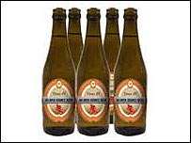
CC Myths
CC is not:
anti-copyright – just another rights management tool for creators
the public domain – just giving certain permission in advance
anti-commercial – can charge for first use, commercial uses, “premium” service, or embed advertising
right for every situation – entirely voluntary, and won’t be best solution for all creators
free as in speech,
not as in beer
Notes:
Non-profit
Founded in 2001
These academics became concerned that the default copyright laws that applied in most countries were restricting creativity in the digital environment by preventing people from being able to access, remix and distribute copyright material online
For instances – most people know that it’s currently illegal under Australian law to record a television show to watch later – but did you also know that, in the absence of any licence, it’s also arguably illegal to print off a webpage for personal use, or to use a song in the background of a home video, or a student film
Even those people who want to make their material more freely available can’t do so without hiring lawyers
Taking inspiration from the open source movement, they decided to develop a set of licences that creators could use to make their material more freely available without giving up their copyright
They wanted to replace the standard “all rights reserved” model with a new, more flexible, “some rights reserved”

Slide 15




Licence Elements
Attribution – attribute the author
Noncommercial – no commercial use
No Derivative Works – no remixing
ShareAlike – remix only if you let others remix
Notes:
The first CC licences were released in 2002
The central to each of the CC licences are the four licence elements – Attribution, noncommercial, no derivative and sharealike
These represent restrictions that copyright owners may want to put on how people can use their material.
As you can see, each of the elements has a symbol that can be used to ‘represent’ each of these elements
this makes the licences easier understand – in theory, once a person is familiar with the CC licences, they should be able to recognise what uses are allowed simply by looking at the symbols

Slide 16
Attribution
Attribution-ShareAlike
Attribution-Noncommercial
Attribution-Noncommercial-ShareAlike
Attribution-NoDerivatives
Attribution-Noncommercial-NoDerivatives
Notes:
Users can mix and match these elements to set the conditions of use for their material
So, for example, an author may be happy to allow private uses of their work, but may want to limit how it can be used commercially.
They may also want people to remix their work, but only so long as that person attributes them and makes the new work available for others to remix
So they can choose the Attribution-noncommercial-sharealike licence

Slide 17

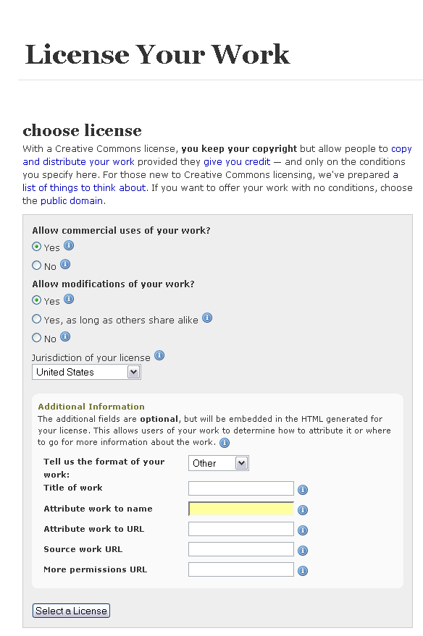
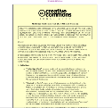
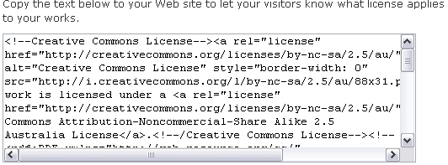
CC system
button
deed
licence
generator
legal code
metadata

Slide 18
Before using CC material
Check that you’re following the licence (ask for extra permission if you need it)‏
Make sure your use isn’t ‘derogatory’
Are there any other rights you need?
Don’t forget to attribute
Use common sense

Slide 19
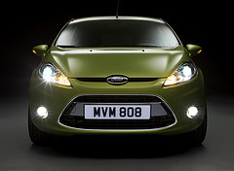

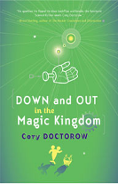
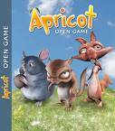

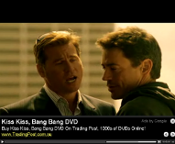



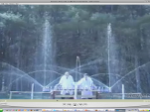

CC as a licensing tool
Facilitate sharing
Community engagement
Increase reach and reputation
Internal rights management
Access new business models
Encourage collaboration and innovation
Notes:
In writing the licences, the main goal was to ensure that the licences are:
Voluntary – contrary to some claims, CC isn’t anti-copyright. It just aims to provide options for those copyright owners who do want to make their material more freely available
Flexible – unlike other parts of the open access movement, CC licences are specifically designed to provide a range of options for licensors, so that they can choose exactly how they want their material to be used
Easy to understand – the academics designing the licences felt that one of the biggest problems with default copyright law is that its so hard for both copyright owners and users to understand. So the licences are specifically designed to be as simple as possible.
And, of course, freely available for everyone to use

Slide 20
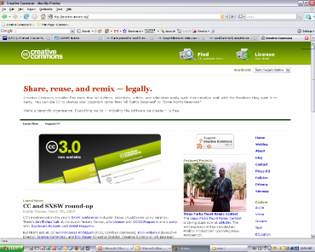
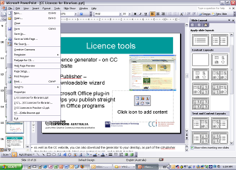
Choosing a licence
Licence generator – on CC website – uses simple questions to determine appropriate licence
Also available:
  ccPublisher – downloadable desktop wizard
  Microsoft plug-in –allows you to CC license straight from Office programs
  Individual site generators eg Flickr
Notes:
As well as the CC website, you can also download the generator to your desktop, as part of the ccPublisher
This helps you automatically label your material as CC, and publish it online
In an interesting development, Microsoft has also recently released an plugin that allows you to label any work created in an Office as CC.
A number of sites also let you licence your material as cc – including flickr, and blip.tv

Slide 21


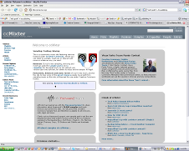
Doesn’t have to be all or nothing
You can apply CC to anything - short works, long works, previews/excerpts, samples, drafts, source material, back catalogue, ‘junk’
You can publish it anywhere – online, offline, own site, popular services, blogs, wikis, remix communities, businesses, peer-to-peer, bittorrent

Slide 22
Before using CC licences
Who do you want to use the material, and when? eg global, perpetual
Are you choosing the right licence? eg do you want them to be able to change your material?
Do you have the rights to license the material? are you using anyone else’s material?

Slide 23
Thanks
creativecommons.org
wiki.creativecommons.org/casestudies
creativecommons.org.au
info@creativecommons.org.au
Carpeted commons by Glutnix, http://www.flickr.com/photos/glutnix/2079709803/in/pool-ccswagcontest07 available under a Creative Commons Attribution 2.0 licence, http://creativecommons.org/licenses/by/2.0/deed.en
Unless otherwise noted, material in this slide show is licensed under a Creative Commons Australia Attribution licence. For more information see http://creativecommons.org/licenses/by/2.5/au/.
part of the Creative Commons international initiative
CRICOS No. 00213J

